Slide 1
Software engineer Project
Student : Yacid abregu
Github : https://github.com/Yabregu/GetInterviews

Slide 2

Project Description
GetInterviews Portal
Manage clients and staff
Have all job search information in one place
Have all performance indicators in one place

Slide 3
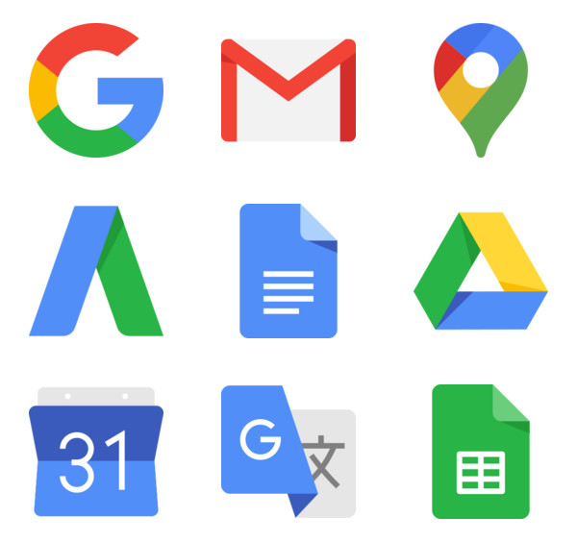
Possible solution

Slide 4
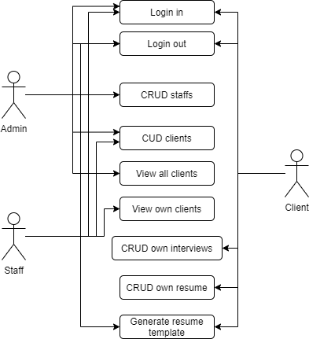
Use cases

Slide 5
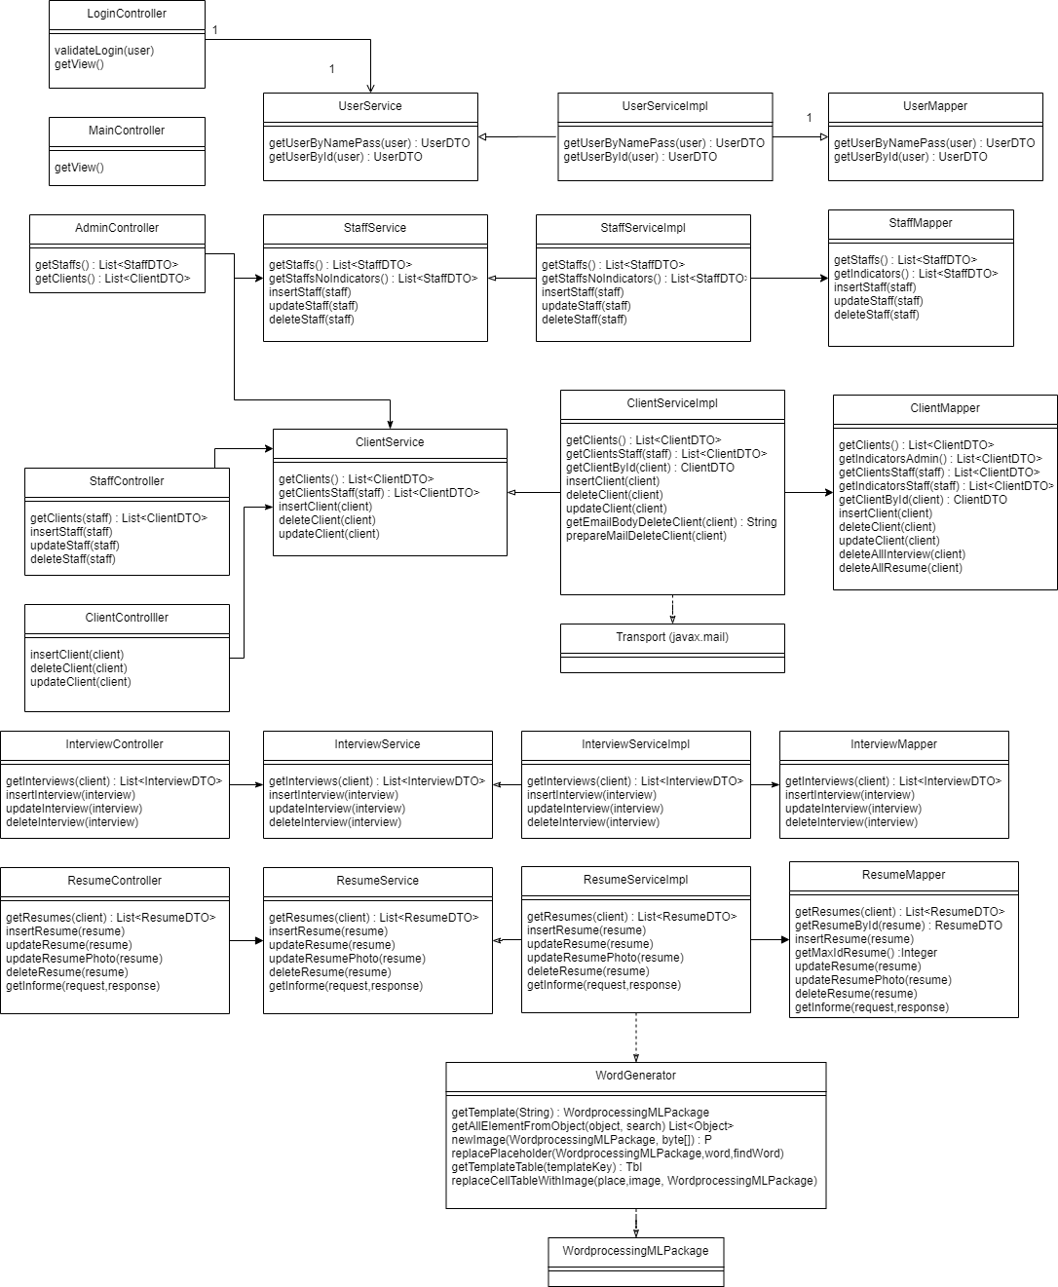
Class diagram

Slide 6
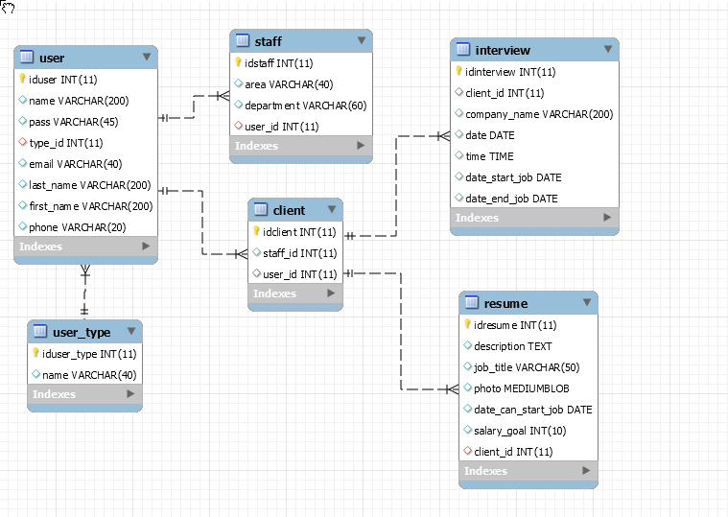
Database desing

Slide 7
Use case description 1
1.2 Read/view staff
Step | User actions | System actions
1 | The admin selects to view a list of staff | The system returns a list of all staff, along with indicators of performance (percentage of clients who found a job, interviews of all clients per week)
2 | The admin selects to view the information of one staff | The system returns the information (first name, last name, email) from the selected staff
3 | The admin selects to view the clients of one staff | The system returns a list of all clients associated to that staff, along with job search indicators (interviews per week, date of last interview)

Slide 8
Use case description 2
2.3 Delete client
Step | User actions | System actions
1 | The actor selects to view a list of staff | The system returns a list of all clients, along with job search indicators. If it is a staff, only views the clients associated to him
2 | The actor selects the client he wants to delete | The system displays a confirmation window, with an obligatory field (explanation) where the actor explains why he deletes the client
3 | The actor confirms the delete | The system deletes the client and deletes the association with the staff it had. Then sends an email to the client, with the explanation

Slide 9
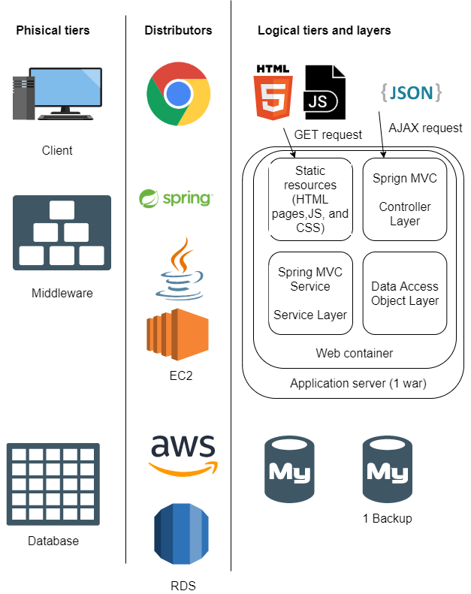
Architecture design

Slide 10
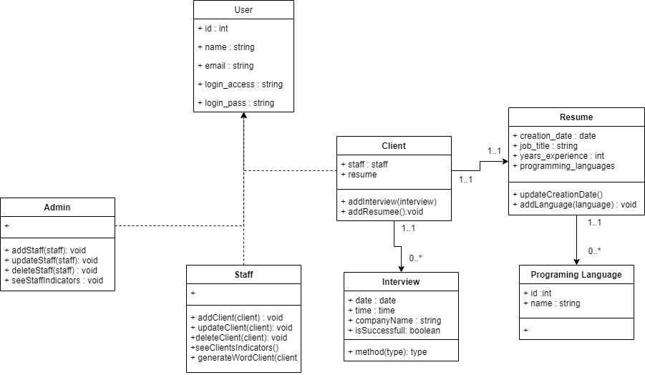
Key abstractions

Slide 11
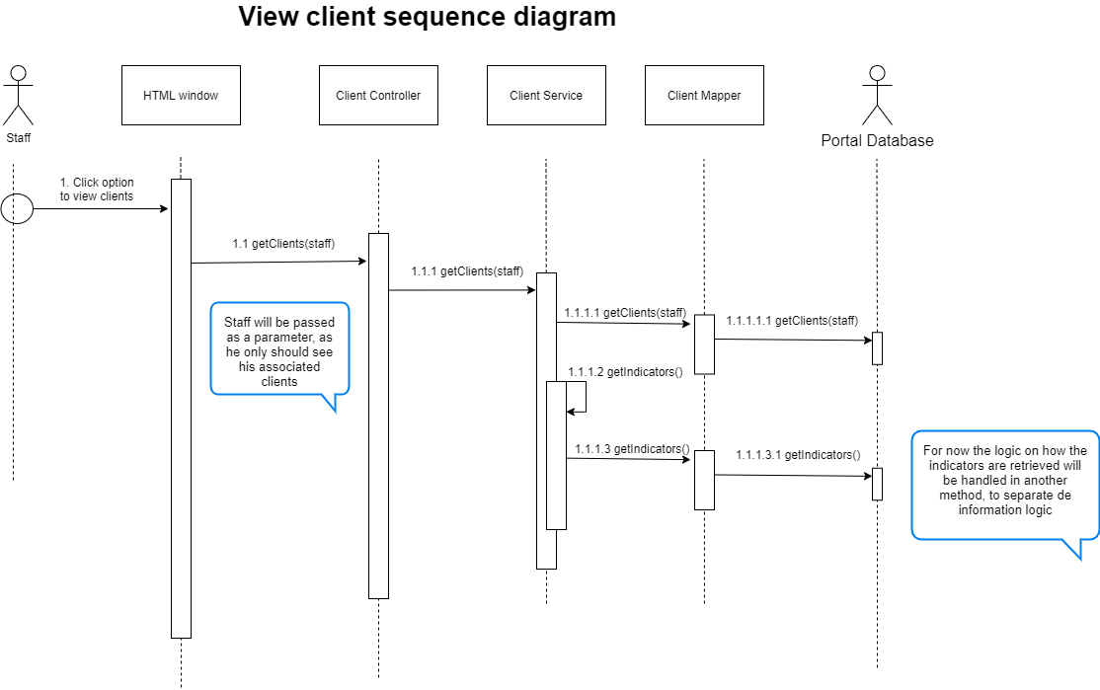

Slide 12
DEMO

